Slide 1


Building and Enlightening Data Professionals in Africa.
An annual conference for all data practitioners in Africa.
#DataFestAfrica22 #DFA22

Slide 2


Containerization of Machine Learning Application
Aboze Brain
FairMoney
@AbozeBrain

Slide 3
Meet Aboze Brain
Aboze Brain John is a data scientist, technical writer and dog father. He has experience in data science and analytics, machine learning, business analysis, product research, and technical writing. He has engaged in end-to-end data science projects and provides knowledge leadership through writing.
Aboze Brain
FairMoney
@AbozeBrain

Slide 4

Containerization of Machine Learning Application

Slide 5
Containers technology outlook
Gartner predicts that by 2025, 85% percent of organizations will run containers in production

Slide 6

What is Virtualization
Virtualization creates a non-physical entity made to appear as if its physical and simulating functionality. In computing, we can create a virtual instance of a physical IT infrastructure and resources such as hardware, storage, network, desktop/OS, CPU/GPU. The two main virtualization technologies are:
Virtual Machines (VMs)
Containers
Notes:
More like distributing a physical machine capacity amount many users or virtual environment. Virtualization has enabled cloud providers serve their existing physical infrastructure to users.

Slide 7
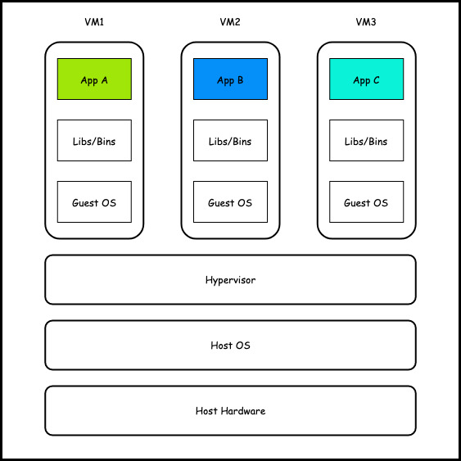
Virtual Machines (VMs)
VMs virtualizes the underlying physical hardware using a hypervisor, thu creating several virtual computers (machines). Each of these VMs runs its OS (Guest OS) required for the respective application, libraries, and functions separately from other VMs. Some popular VMs software are VMware, Microsoft Hyper-V, QEMU, Citrix Hypervisor.

Slide 8
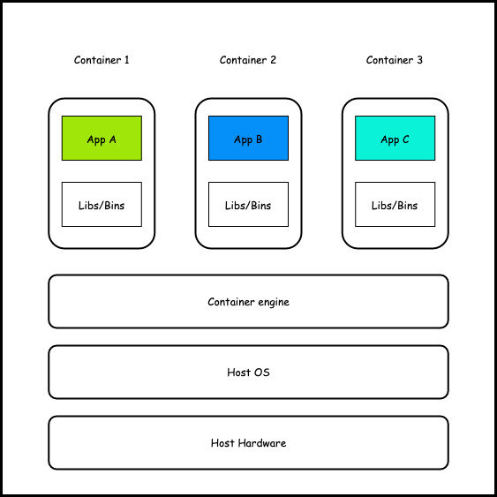
Containers
Containers virtualize the Host OS, where all the isolated containers share the host kernel. Containers packages the application alongside its dependencies and binaries as a single executable unit. Container technology gets its name from the shipping industry. Some popular container software are Docker, Google kubernetes engine, Amazon ECS, LXC, Azure Kubernetes Service.

Slide 9
Why containerized application?
Both VMs and containers are similar in goals, to isolate an application and its dependencies, binaries and configuration files into an executable self-contained unit. However, some of the benefits to containerize application includes:
Portability & flexibility (write once, run anywhere)
Lightweight
Scalability
Quick creation and deployment
Debugging (Fault isolation)
Improve security
Greater efficiency

Slide 10

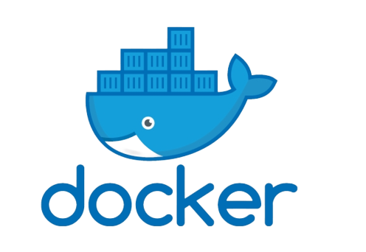
Where Docker comes in
Docker is an open-source tool for building, deploying and managing containerized applications. Docker is powered by the linux kernel utilizing features such as kernel namespaces and control groups (cgroups) to manage host system resources more efficiently.
Since Docker depends on the linux kernel features (native linux), Windows and Mac system can’t run the linux containers directly. Docker tries to solve this compatibility issue with Docker Desktop, where its internal workings involves installing a micro Linux VM on which it runs the containers. The micro Linux VM plumbs into the Host OS and give containers access to host hardware resources.

Slide 11
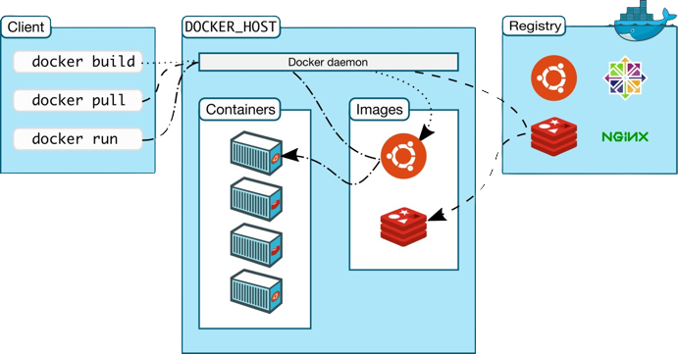
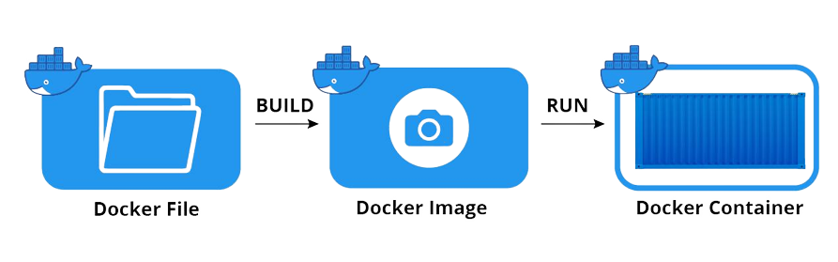
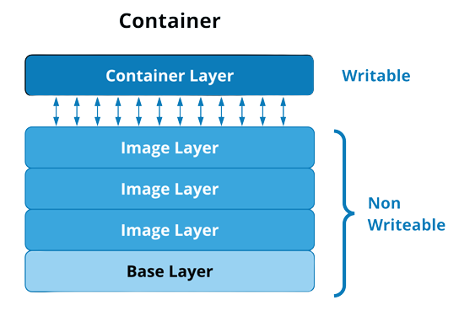
Demystifying some terminologies
Docker engine
Docker client
Docker daemon
Docker desktop
Dockerfile
Docker image
Docker containers
Docker registry
Docker vs Virtualenv

Slide 12

Use case: Bank Customer churn Prediction

Slide 13
Creating Dockerfile and building image
# Start by pulling the python image
FROM python:3.9.10
# Set and create the working directory to /app
WORKDIR /app
# Copy the current directory contents into /app
COPY . /app
# Informs docker that this container should listen to network port 8501 at runtime
EXPOSE 8501
# Install the dependencies and packages in the requirements file
RUN pip install --upgrade pip
RUN pip install -r requirements.txt
# Prepare the container to be executable
CMD ["streamlit", "run", "app.py"]
Firstly start our Docker desktop (for Mac and Windows users) so the docker daemon can run.
Next, create a Dockerfile in the app directory of our project by creating a file and naming it Dockerfile with no extension and adding the snippet in that file
Next, proceed to build our docker image using the tag(mutable reference name) as follows:
docker build -t image_name .

Slide 14
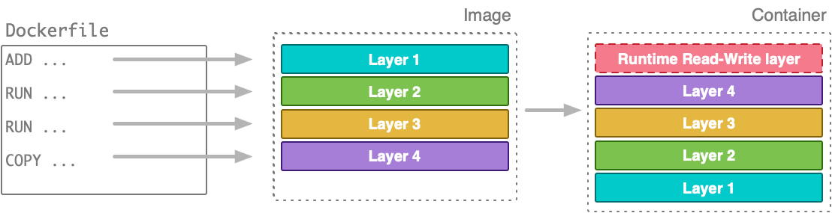
Docker image
Docker container
Docker images are the templates for building containers.
The image will contain the code and required dependencies to execute the code.
The image can be used to create multiple containers based of the image
Docker images can be built from pre-existing image or build a custom image with a Dockerfile
Docker images are read-only and layer based.
Docker containers are a running instance of a docker image.
Containers are an additional layer to the image layer, so the container doesn’t copy the code and dependencies again
We can run containers using the syntax
docker run image

Slide 15
Running a container
Running container in detached mode using the flag: -detach or -d
Publishing a container port to the host using:
--publish host_port:container_port or -p host_port:container_port
Assign a name to container using the flag:
--name
Altogether we can run the container as follows:
docker run -d -p host_port:container_port --name container_name image
Firstly, we can run on a container in detached mode.
Containers are isolated environments from our local machine; hence since our app is running on a particular port (8501), we need to instruct our host machine to make available a port that will listen to the container port.
Lastly, we can give our container a name rather the automatic generated name.

Slide 16

Deploying our image to Docker Hub
Sign up on Docker Hub if you don't already have an account.
After creating an account and successfully logging in, click on the Repositories navigation bar and create a new repository.
Next, with our Docker Hub repository set up, we need to create a connection between Docker Hub and our local machine: docker login
Upon successful login, before we push our image to the created repository, we have to rename our image to the standard format following <your-docker-hub-username>/<repo-name> naming syntax as follows: docker tag existing_image_name <your-docker-hub-username>/<repo-name>
Lastly, we push the image to Docker Hub as follows:
docker push <your-docker-hub-username>/< repo-name>
Docker Hub is a service provided by Docker that serves as a community of repositories where Docker users create, test, manage, store and share container images. It is free for public repositories and has a subscription plan for private repositories.

Slide 17


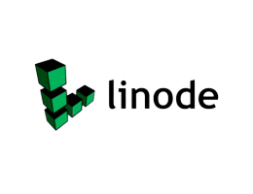


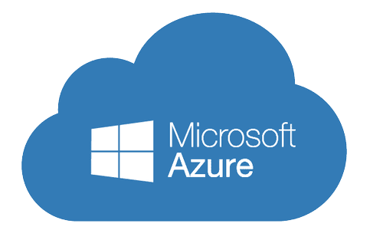
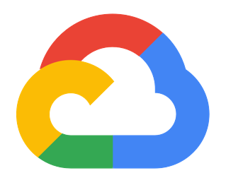


Deploying our containerized app to the cloud
We need hosting our containerized app on the cloud to leverage cloud infrastructure rather than on-premise.
This cloud infrastructure will also enable our hosted applications to be accessed and interacted with over the internet.

Slide 18
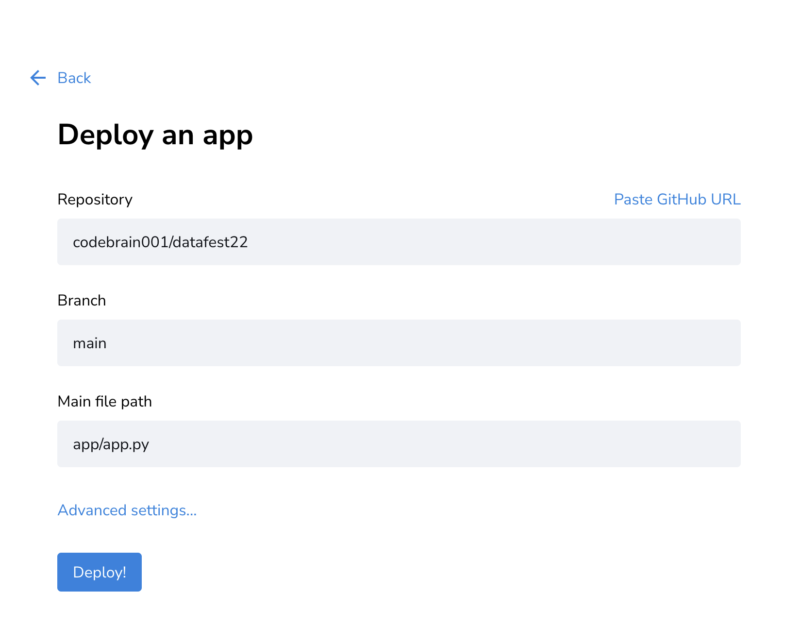
Deploying to Streamlit cloud
Set up a GitHub account and create a GitHub repository
Push your application and dependencies to GitHub repository
Set up a Streamlit Cloud account
Create a new app and link to the GitHub repository that contains your app
Click on deploy!
Your app is public with URL

Slide 19
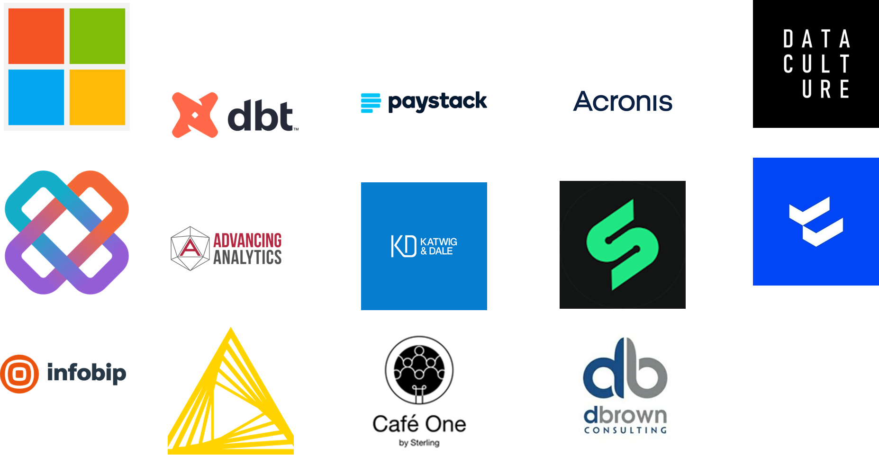
Thank you Sponsors

Slide 20

THANK
YOU!

